Slide 1


Rockbuster Stealth
Ruth Forster, June 2022

Slide 2

Objective
Analyse Rockbuster’s historical rental data from their stores to form the strategy of launching an online video rental service.
Key Questions
Which movies contributed the most/least to revenue gain?
What was the average rental duration for all videos?
Which countries are Rockbuster customers based in?
Where are customers with a high lifetime value based?
Do sales figures vary between geographic regions?

Slide 3
Data Overview
1000
Movies
599
Customers
109
Countries
3-7 days
Rental duration
$2.99
Avg Rental cost
$19.98
Avg Replacement cost

Slide 4



What is the average rental duration for all videos?

Slide 5
What is the average rental duration for all videos?
 | Min | Max | Average
Rental Duration | 3 | 7 | 5
Rental Rate | $0.99 | $4.99 | $2.99
Replacement Cost | $9.99 | $29.99 | $19.98
Movies are rented for an average of 5 days at a cost of $2.99

Slide 6

Which movies contributed the most/least to revenue gain?

Slide 7
There are no key identifiable drivers behind the highest and lowest revenue generating movies such as Genre or Rating. The percentage of revenue from the top 10 movies is small meaning we are not heavily reliant on certain titles to drive revenue.
Top 10 Movies
Bottom 10 Movies
Movie Title | Genre | Rating | Total Revenue | Percentage of Revenue | Count of Rentals
Telegraph Voyage | Music | PG | $ 215.75 | 0.35% | 25
Zorro Ark | Comedy | NC-17 | $ 199.72 | 0.33% | 28
Wife Turn | Documentary | NC-17 | $ 198.73 | 0.32% | 27
Innocent Usual | Foreign | PG-13 | $ 191.74 | 0.31% | 26
Hustler Party | Comedy | NC-17 | $ 190.78 | 0.31% | 22
Saturday Lambs | Sports | G | $ 190.74 | 0.31% | 26
Titans Jerk | Sci-Fi | PG | $ 186.73 | 0.30% | 27
Harry Idaho | Drama | PG-13 | $ 177.73 | 0.29% | 27
Torque Bound | Drama | G | $ 169.76 | 0.28% | 23
Dogma Family | Animation | G | $ 168.72 | 0.28% | 28
Grand Total |  |  | $ 1,890.40 | 3.08% | 259
Movie Title | Genre | Rating | Total Revenue | Percentage of Revenue | Count of Rentals
Oklahoma Jumanji | New | PG | $ 5.94 | 0.01% | 6
Duffel Apocalypse | Documentary | G | $ 5.94 | 0.01% | 6
Texas Watch | Horror | NC-17 | $ 5.94 | 0.01% | 6
Freedom Cleopatra | Comedy | PG-13 | $ 5.95 | 0.01% | 5
Young Language | Documentary | G | $ 6.93 | 0.01% | 7
Rebel Airport | Music | G | $ 6.93 | 0.01% | 7
Cruelty Unforgiven | Classics | G | $ 6.94 | 0.01% | 6
Treatment Jekyll | Drama | PG | $ 6.94 | 0.01% | 6
Lights Deer | Classics | R | $ 7.93 | 0.01% | 7
Japanese Run | Horror | G | $ 7.94 | 0.01% | 6
Grand Total |  |  | $ 75.32 | 0.12% | 68

Slide 8
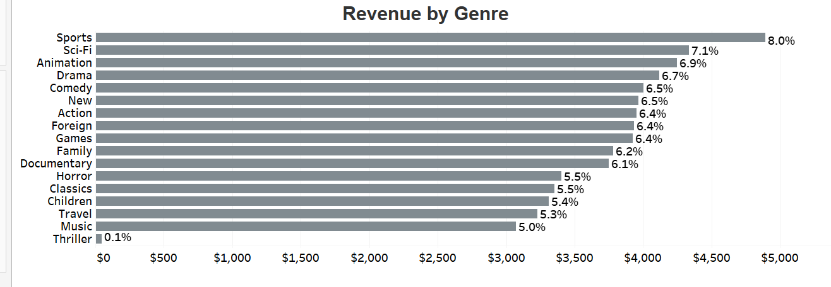
Sports is the highest revenue genre. There is little spread between the proportion of sales across genres meaning we aren’t heavily reliant on certain genres. Thriller is the least popular genre at less than 0.1% of revenue.
Customers enjoy a wide variety of genres from the Rockbuster selection.

Slide 9
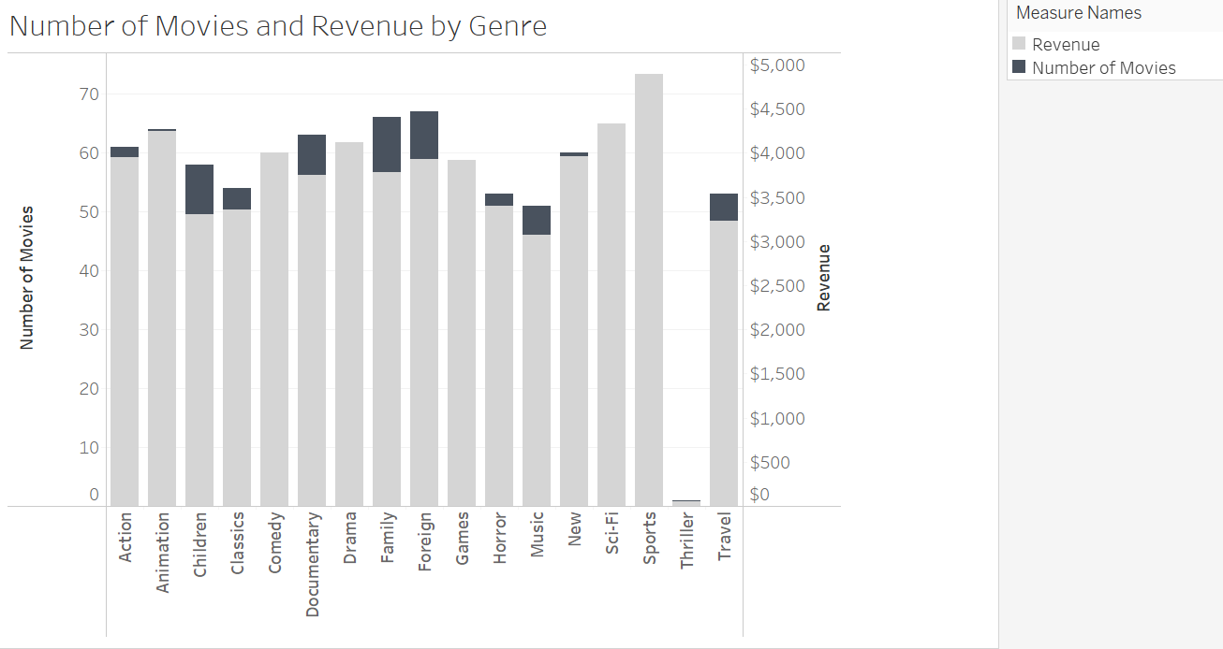
Although the majority of genres generate significant revenue some have been over invested in compared to the number of rentals. Mainly: Children Documentary Family Foreign
Reducing selection of these genres allows more investment into best performing genres.

Slide 10
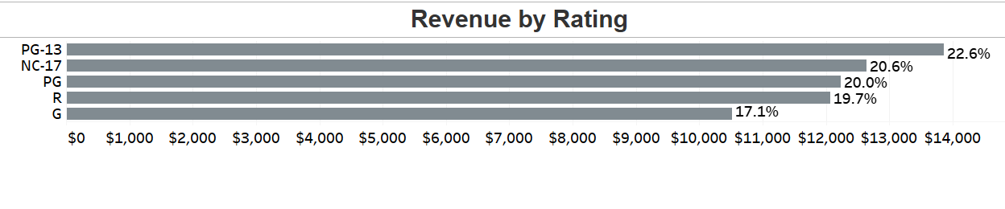
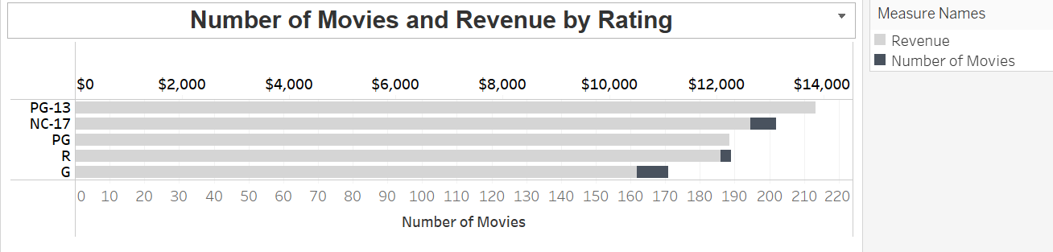
PG-13 rating generates the most revenue but based on proportion of sales there is no outstanding driver. Selection of G and NC-17 could be reduced to invest in more PG and PG-13 titles.

Slide 11

Which countries are Rockbuster customers based in?

Slide 12
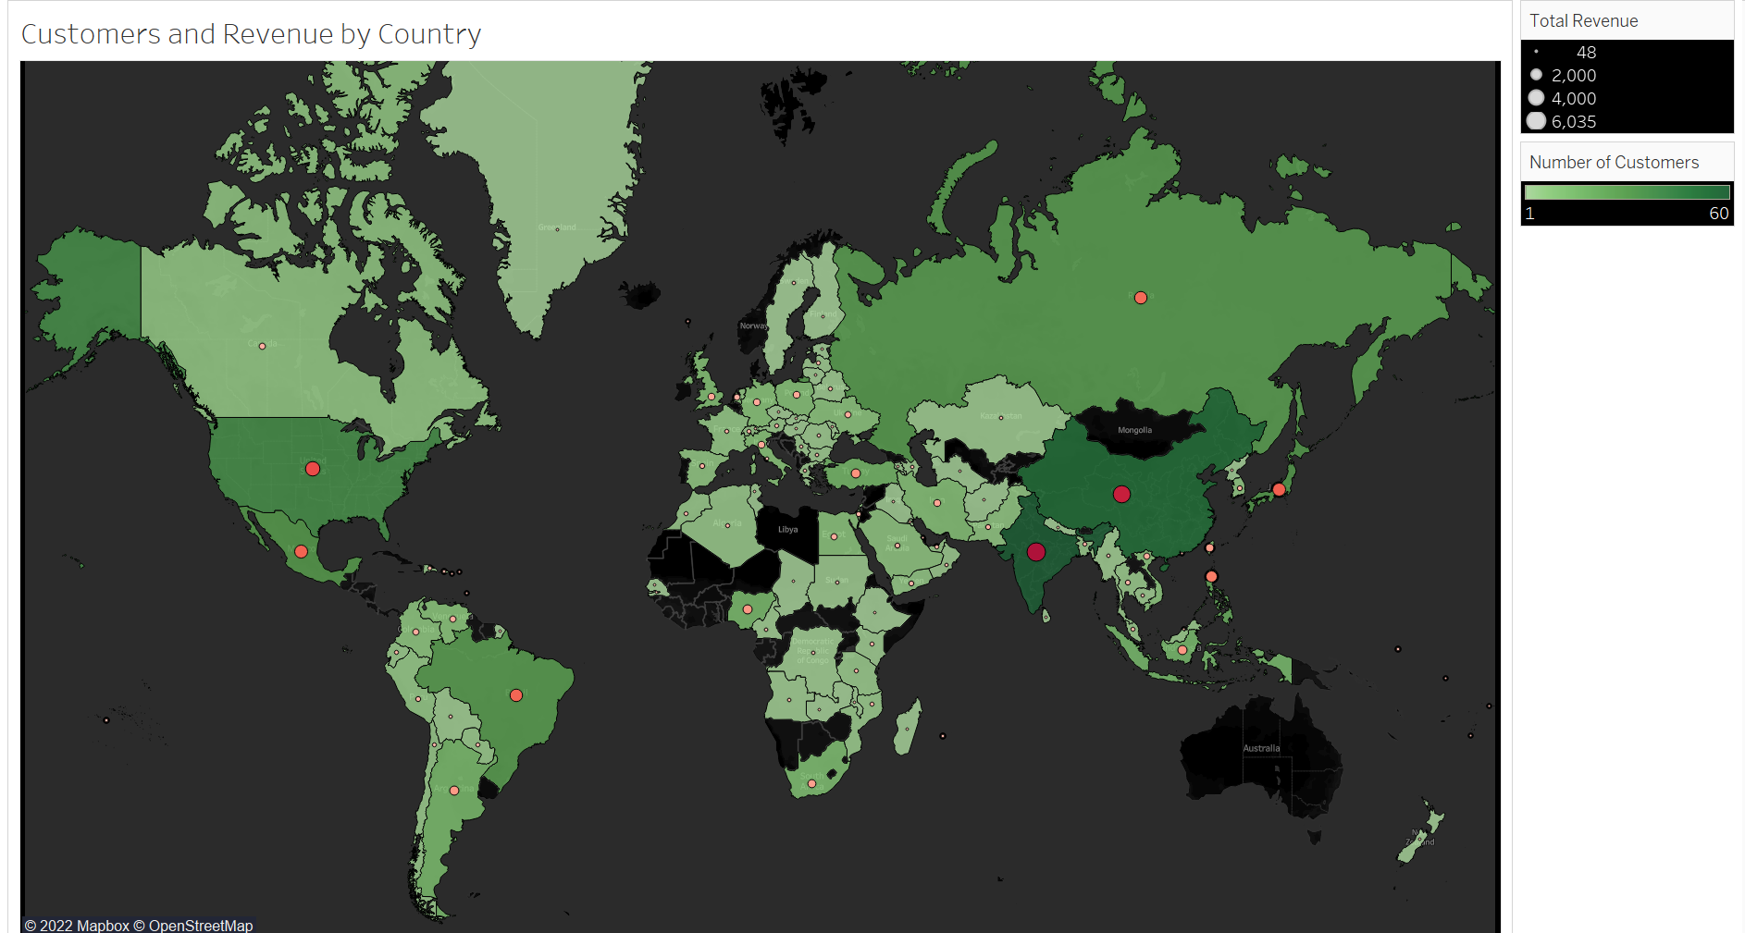
We have a global customer base with active customers in over 100 countries.

Slide 13
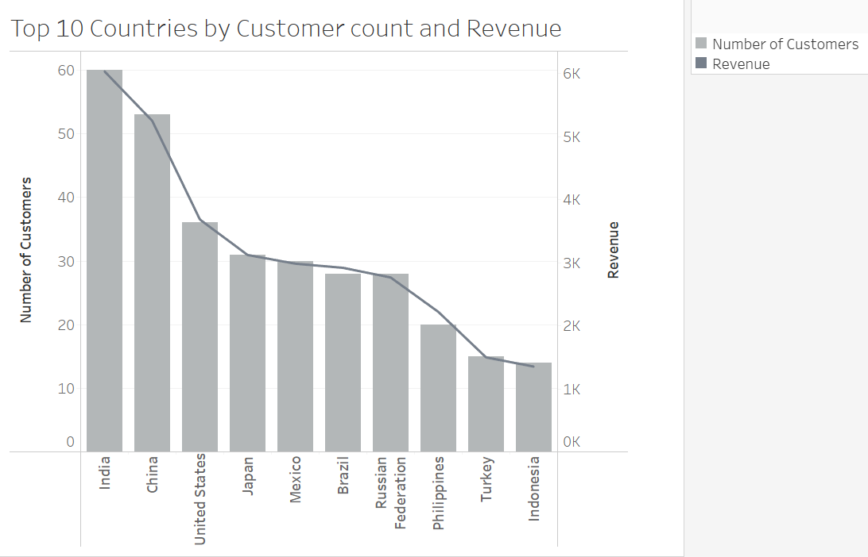
There is a correlation between customer count and revenue. Our top 10 countries are the same for both metrics and account for over 50% of both revenue and customer count. Top 5 Countries: India China USA Japan Mexico

Slide 14

Where are customers with a high lifetime value based?

Slide 15

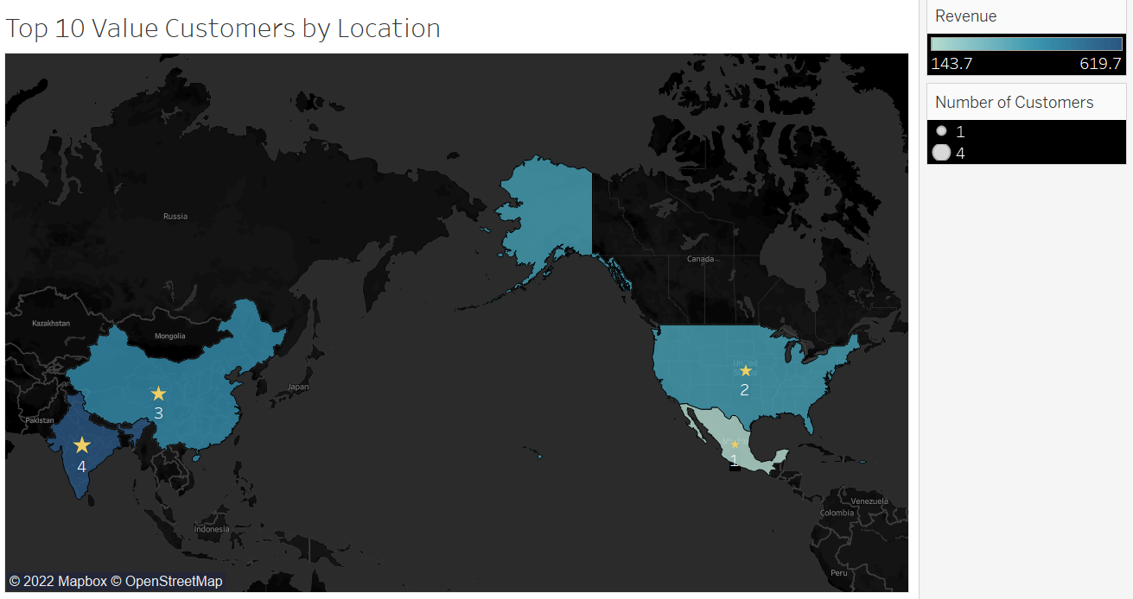
Our top 10 customers within our top 5 countries are spread across 10 different cities within USA, India, China and Mexico,
They rent on average 33 movies a year. Almost double the overall average of 18.
The proportion of revenue generated by the top 10 customers is 4% of total revenue.
If targeting specific customers, we should expand criteria to reach a larger potential revenue base.
First Name | Last Name | City | Country | Revenue | Number of Rentals
Karl | Seal | Cape Coral | United States | $ 208.58 | 42
Ana | Bradley | Memphis | United States | $ 167.67 | 33
Mike | Way | Valparai | India | $ 162.67 | 33
Lena | Jensen | Halisahar | India | $ 154.70 | 30
Tim | Cary | Bijapur | India | $ 154.66 | 34
Guy | Brownlee | Zhoushan | China | $ 151.69 | 31
Tonya | Chapman | Bhilwara | India | $ 147.71 | 29
Stacey | Montgomery | Fuyu | China | $ 146.67 | 33
Alex | Gresham | Uruapan | Mexico | $ 143.68 | 32
Margie | Wade | Lengshuijiang | China | $ 142.67 | 33

Slide 16
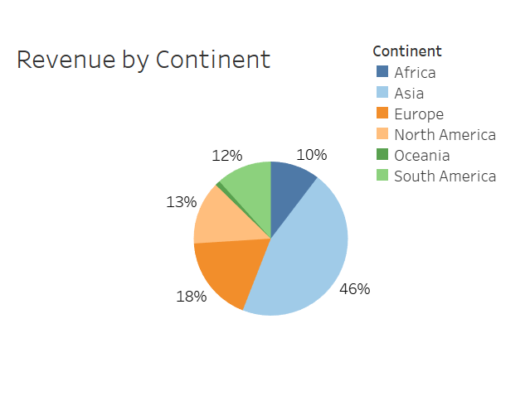
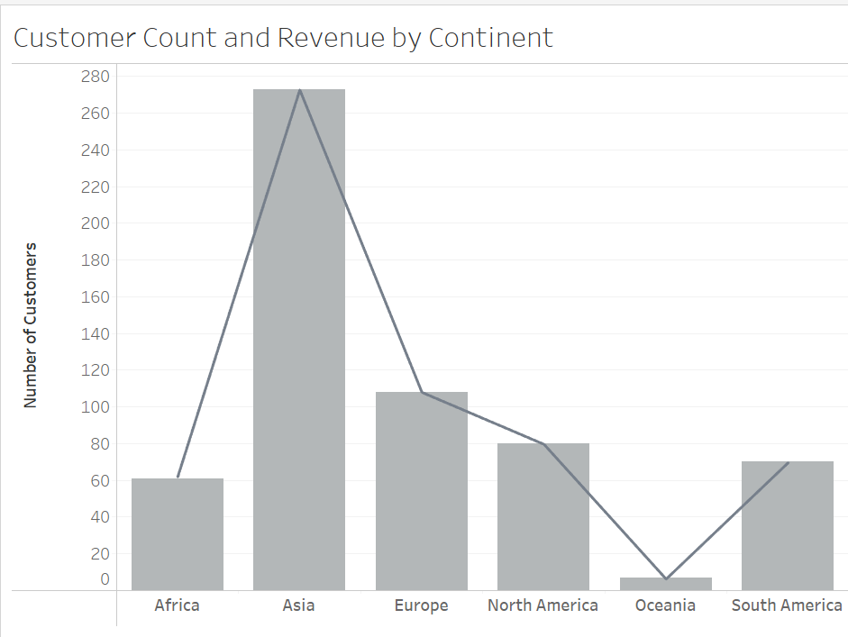
Do sales figures vary between geographic regions?
Asia has the highest customer base and drives the most revenue at 46% of the mix.
Revenue is directly correlated to number of customers meaning if we can attract customers, we are likely to see revenue from them.

Slide 17
Launch Strategy
Findings
Recommendations
Certain geographical areas generate a high proportion of the revenue and have a strong current customer base.
Revenue is generated from a variety of genres and ratings. Customers enjoy a wide selection.
High value customers are loyal and rent a larger than average number of movies.
Review movie catalogue to align with revenue mix.
Reduce titles in :
Children, Documentary, Family & Foreign
G & NC-17
Increase titles in:
Sports, Sci-fi and Drama
PG & PG-13

Slide 18
Next Steps
Deeper analysis into top 5 countries in order to draft the launch strategy for these regions.
Further analysis into customer revenue and rentals as well as previous marketing campaigns. Re-defining high value customer criteria to capture a larger customer base and develop incentive to offer them.
Review movie catalogue to align with revenue mix.
Reduce titles in :
Children, Documentary, Family & Foreign
G & NC-17
Increase titles in:
Sports, Sci-fi and Drama
PG & PG-13

Slide 19
Thank you. Any Questions?
Ruth Forster
Ruth@Rockbuster.com
https://public.tableau.com/app/profile/ruth5282/viz/RockbusterVizs/RockbusterStealthVizs

